Slide 1
Beyond Disaster: Taking a Broader Look at Natural Hazards and Social Vulnerability
James R. Elliott & Junia Howell
Disasters, Extreme Events, Trauma & Resilience Conference
UC Riverside, Nov. 7, 2016

Slide 2
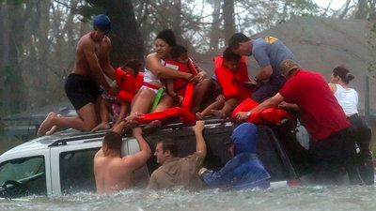
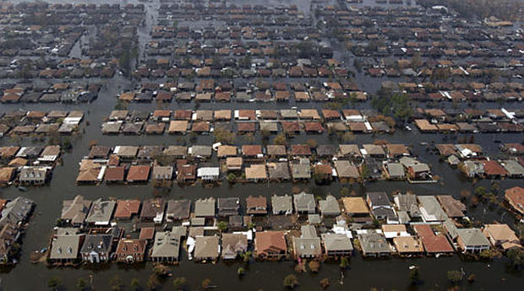
Disaster
Hurricane Katrina
New Orleans 2005

Slide 3
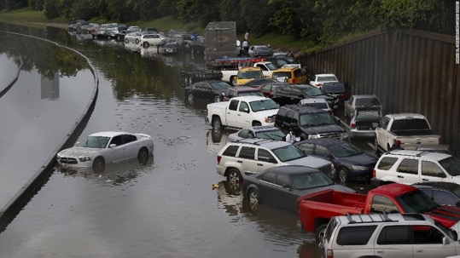
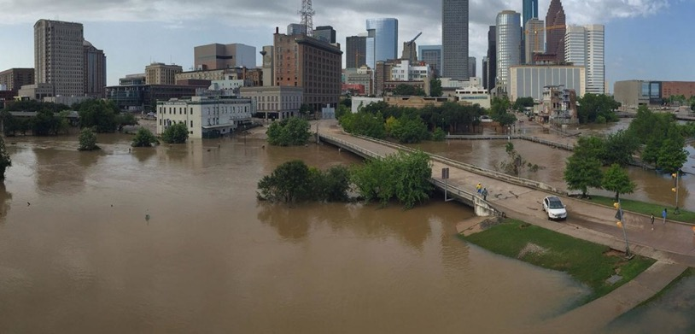
Flash Floods
Houston
2016

Slide 4
Beyond Disaster
Successive
Interactions
Disaster ~ Hazard Event X Social Vulnerabilities
Pervasive & Ongoing

Slide 5
California, 2015
Federal Disasters
Number: 1
Valley Fire (Sept – Oct)
1,274 residences damaged
Direct Property Damage:
$10.1 Million
All Natural Hazards
Number: 374 county-events
Direct Property Damage:
$109.8 Million

Slide 6
Alternative Approach
Event Centered Analysis
Population Centered Analysis
Notes:
In the present study, we do this by shifting our analytical approach. Previous studies have taken an event-center research approach. That is, they select a specific natural disasters and examine individuals who were effected by that event. If longitudinal, they tract these people over time and space. Yet, we employ a population centered approach. Specifically, we take a random sample of U.S. adults and follow them through time tracking the extent to which their counties experience natural hazard damage and how their lives are effected by these disasters.

Slide 7
Data and Methods
Data Sets
—Spatial Hazard Events and Losses Database for the United States (SHELDUS)
1999-2011
—Panel Study of Income Dynamics (PSID)
1999-2011
—Census Data
2000 Long Form and 2006-2010 ACS
Notes:
To do this, we utilized three distinct data sets. First, our information on natural hazard damage comes from the Spatial Hazard Events and Losses Database for the United States (SHELDUS) which is a government-funded database the gathers county-level data on natural disasters with at least one death or $25,000 in direct property damage. Second, for our random population sample we use the restricted geocoded Panel Study of Income Dynamics (PSID) a longitudinal study which starting in 1968 has tracked selected families, their children, and their children’s children. In 1999, the PSID expanded its original sample to capture new immigrant families that had moved to the United States after 1968. We use this later, larger sample to take advantage of robust numbers of Hispanic, Asian and Other race respondents, in addition to Whites and Blacks. Respondents in our sample were interviewed every two years from 1999 through 2011. Lastly, we use the 2000 Census Long Form and the 2006-2010 5-year summary files from the American Community Survey for demographic data on resident’s neighborhoods and counties.

Slide 8
Data & Methods
Dependent Variable
Residential Instability
# of Moves since last survey
(Pribesh and Downey 1999; Sampson et al. 1999; Dong et al. 2005; Sharkey and Sampson 2010; Desmond and Gershenson 2016)
Key Independent Variable
Natural Hazard Damage to Property
County-Level Totals (logged)

Slide 9
Control Variables
Individual-Level
—Race (White, Black, Latino, Other)
—Foreign Born
—Education (years completed in school)
—Age (and age squared)
Family and Household-Level
—Married
—Parenthood
—Annual Household Income (logged)
—Rooms Per Capita
Neighborhood and County-Level
—Neighborhood Socioeconomic Status
—Total County Population
—Rural/Urban Scale (1=most urban; 9 = most rural)

Slide 10
Unit of Analysis
Individual—Stratified by Gender
Models: Negative Binomial Regressions
1. Aggregated: 1999 - 2011
2. Longitudinal: 1999-01, 2001-03…2009-11

Slide 11
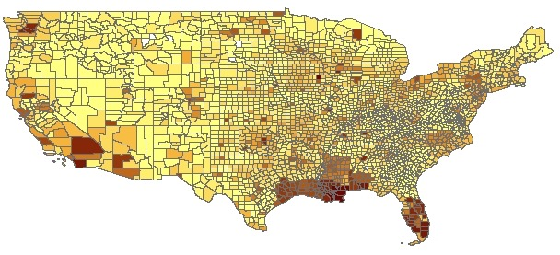
Results
Direct Property Damage
From March 1999 to 2011

Slide 12
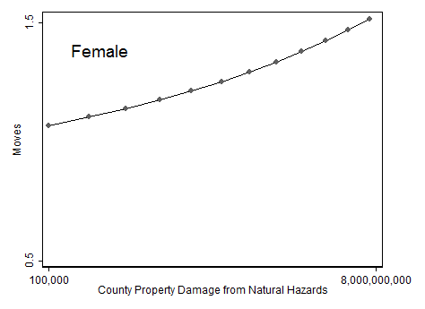
Results
**Baseline Model—No Controls

Slide 13
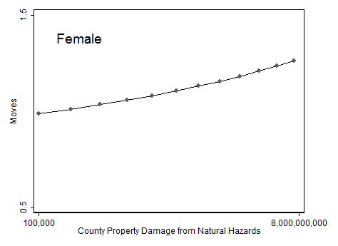
Results
**Controls: Race, Nativity, Education, Age, Married, Children, Income, Ownership, Rooms per Cap, Neighborhood SES, Urban/Rural, Total Pop

Slide 14
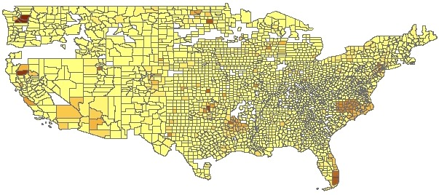
Results
Direct Property Damage
From March 1999 to 2001

Slide 15
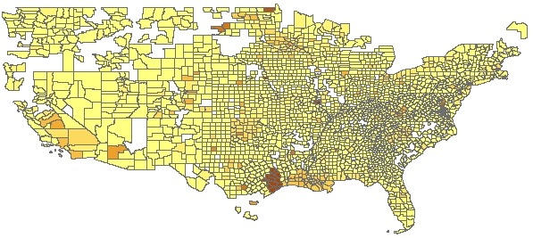
Results
Direct Property Damage
From March 2001 to 2003

Slide 16
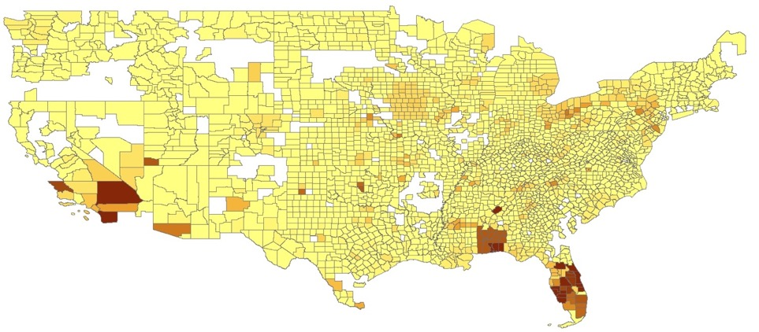
Results
Direct Property Damage
From March 2003 to 2005
Hurricanes Ivan and Charley (2004)
Wildfires (2003)

Slide 17
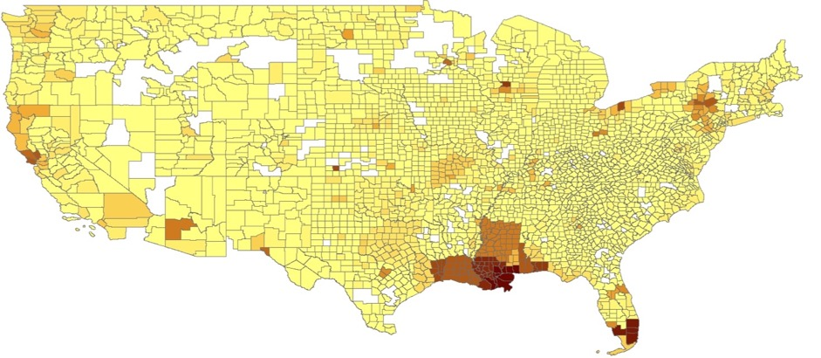
Results
Direct Property Damage
From March 2005 to 2007
Hurricane Katrina (2005)

Slide 18
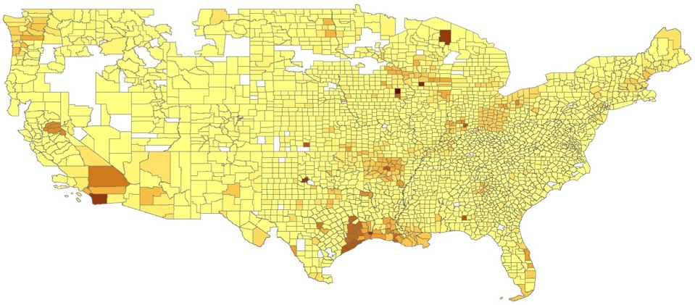
Results
Direct Property Damage
From March 2007 to 2009
Iowa Flood (2008)
Hurricane Ike (2008)

Slide 19
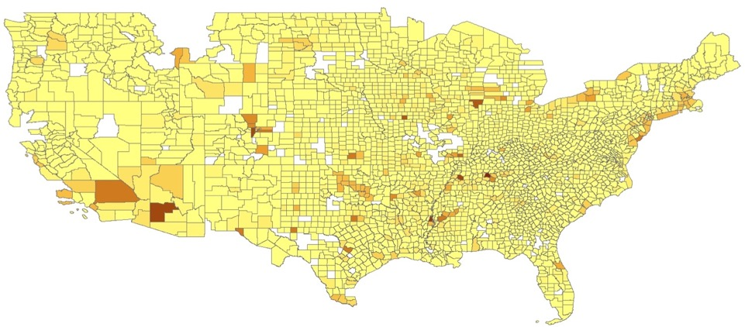
Results
Direct Property Damage
From March 2009 to 2011

Slide 20
Results
Direct Property Damage
From March 1999 to 2011

Slide 21
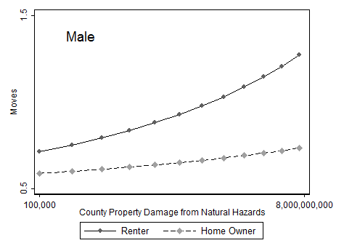
Results

Slide 22
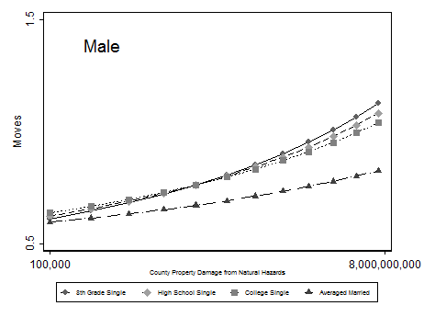
Results

Slide 23
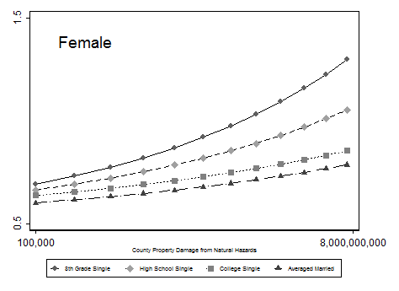
Results

Slide 24
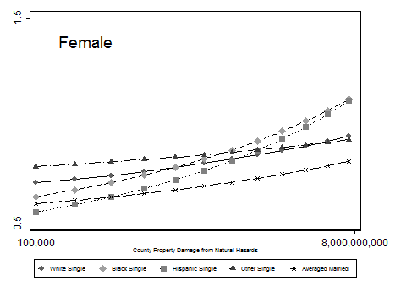
Results

Slide 25
Residential Instability
Socially Vulnerable
Cumulative
Hazard Damage
over Time
Socially Privileged

Slide 26
Beyond Disasters
As (non-disaster) hazard damages accrue over time, so does residential instability
This is multiplicatively so among socially vulnerable (especially women of color)
Future planning should go beyond extreme events & aim for housing resilience

Slide 27
Contact
James R. Elliott Junia Howell
James.R.Elliot@rice.edu JuniaHowell@rice.edu
Department of Sociology
Rice University

Slide 28
Additional Material

Slide 29
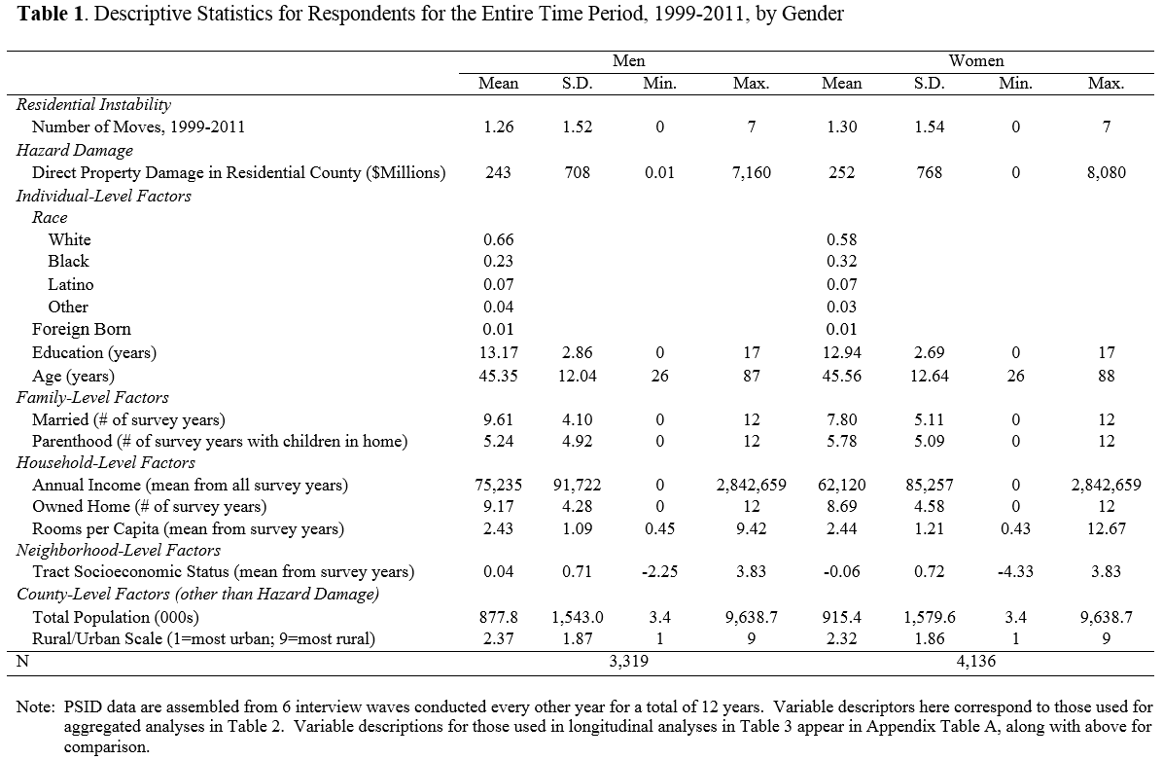
Tables

Slide 30
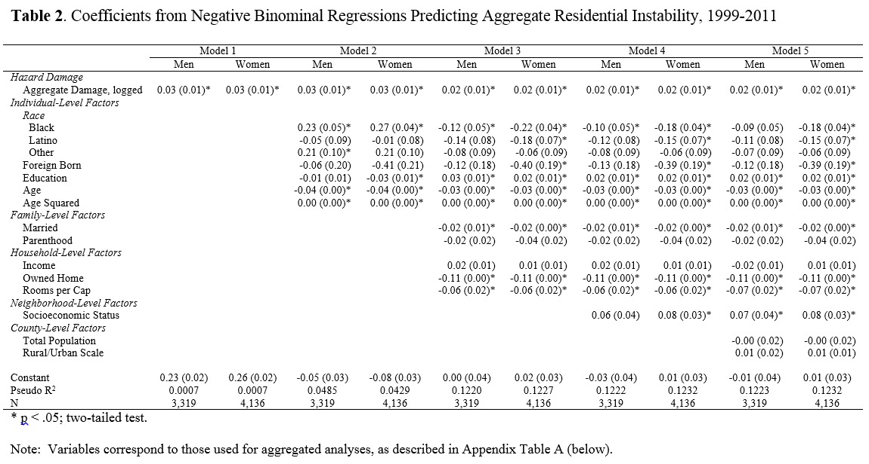
Tables

Slide 31
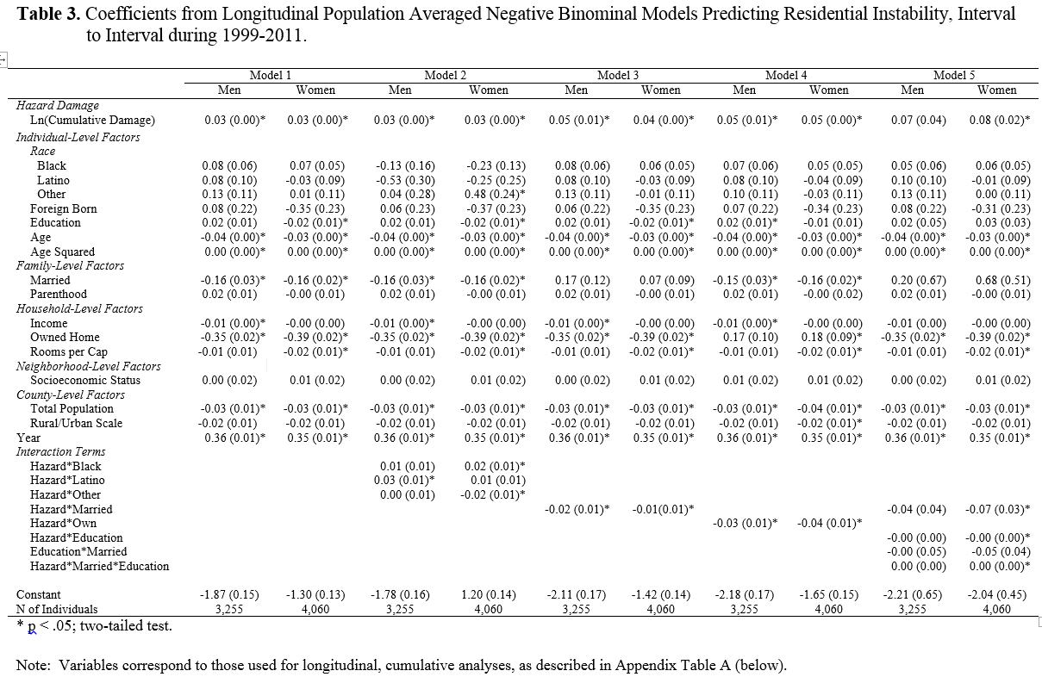
Tables

Slide 32
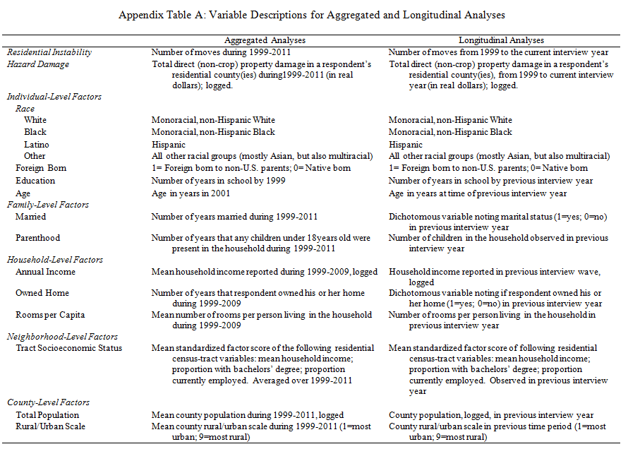
Tables

Slide 33
Results

Slide 34
Results
(mean across years)

Slide 35
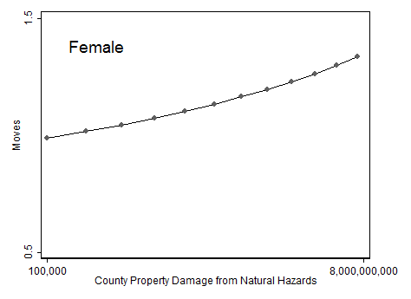
Results
**Controls: Race, Nativity, Education, Age—Graph reflects Native Whites of average education & age

Slide 36
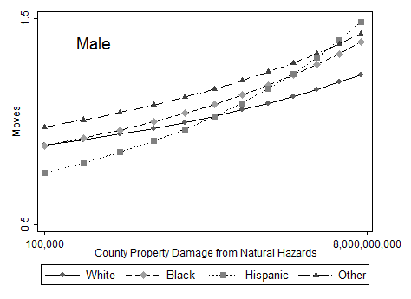
Results

Slide 37
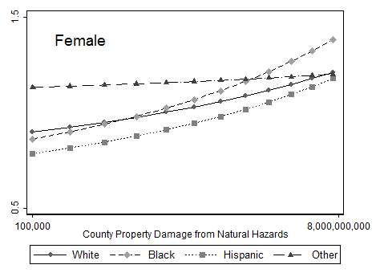
Results

Slide 38
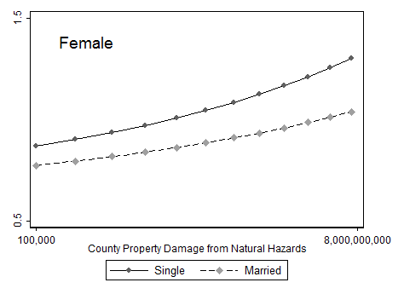
Results

Slide 39
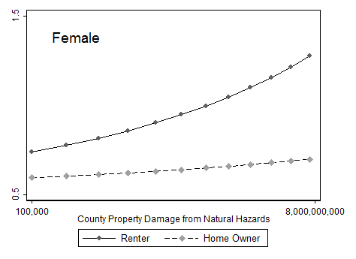
Results

